Slide 1
Enegy anaylis Gent

Slide 2
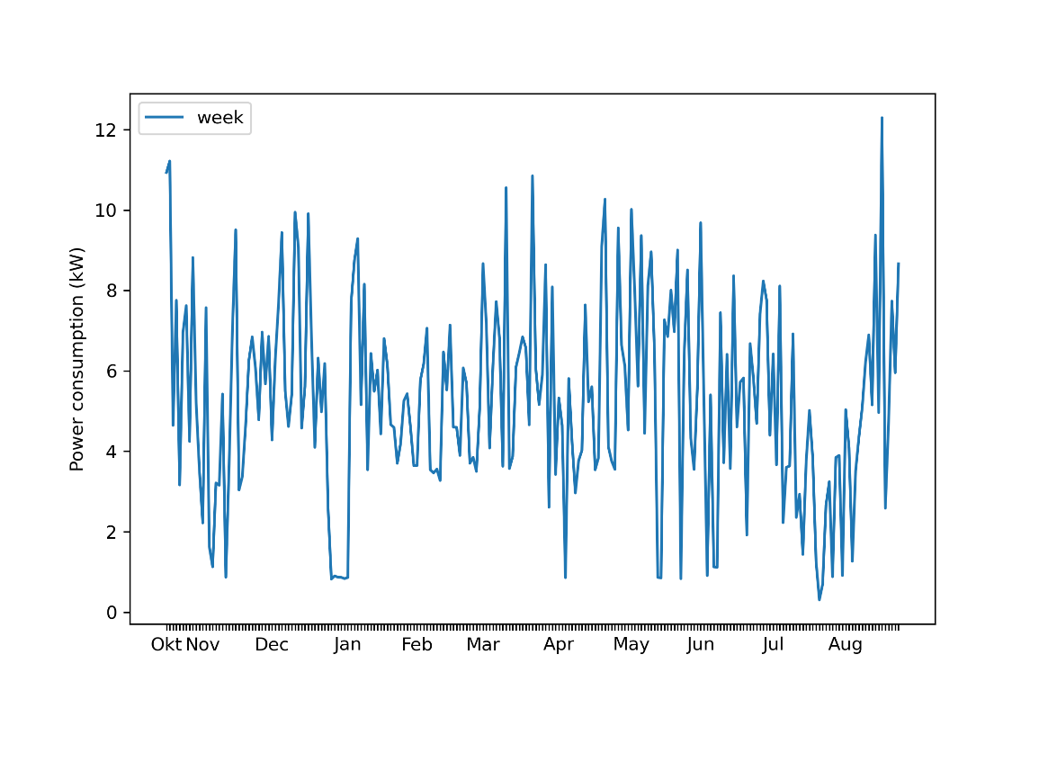
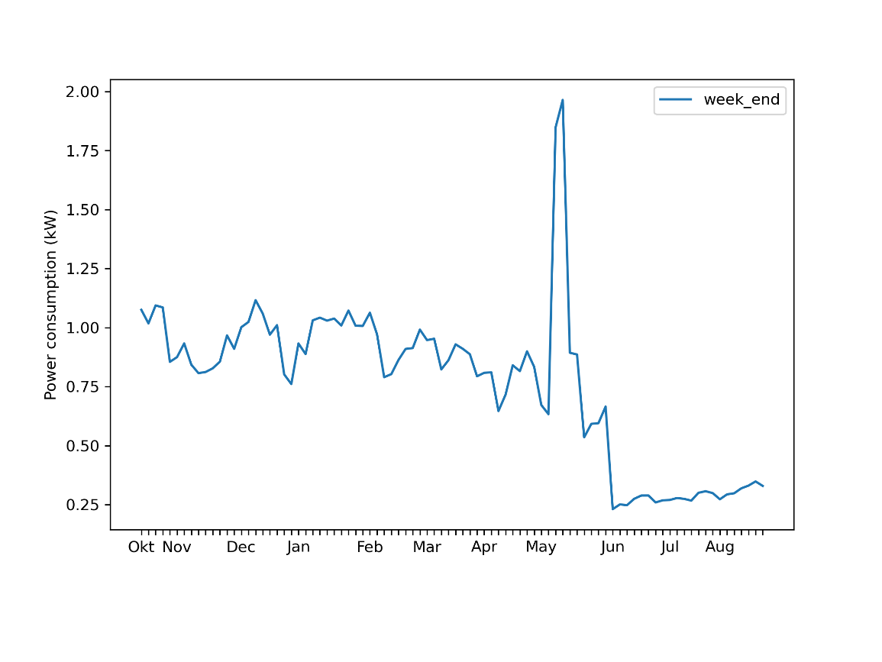
Average daily power consumption
Week Weekend

Slide 3
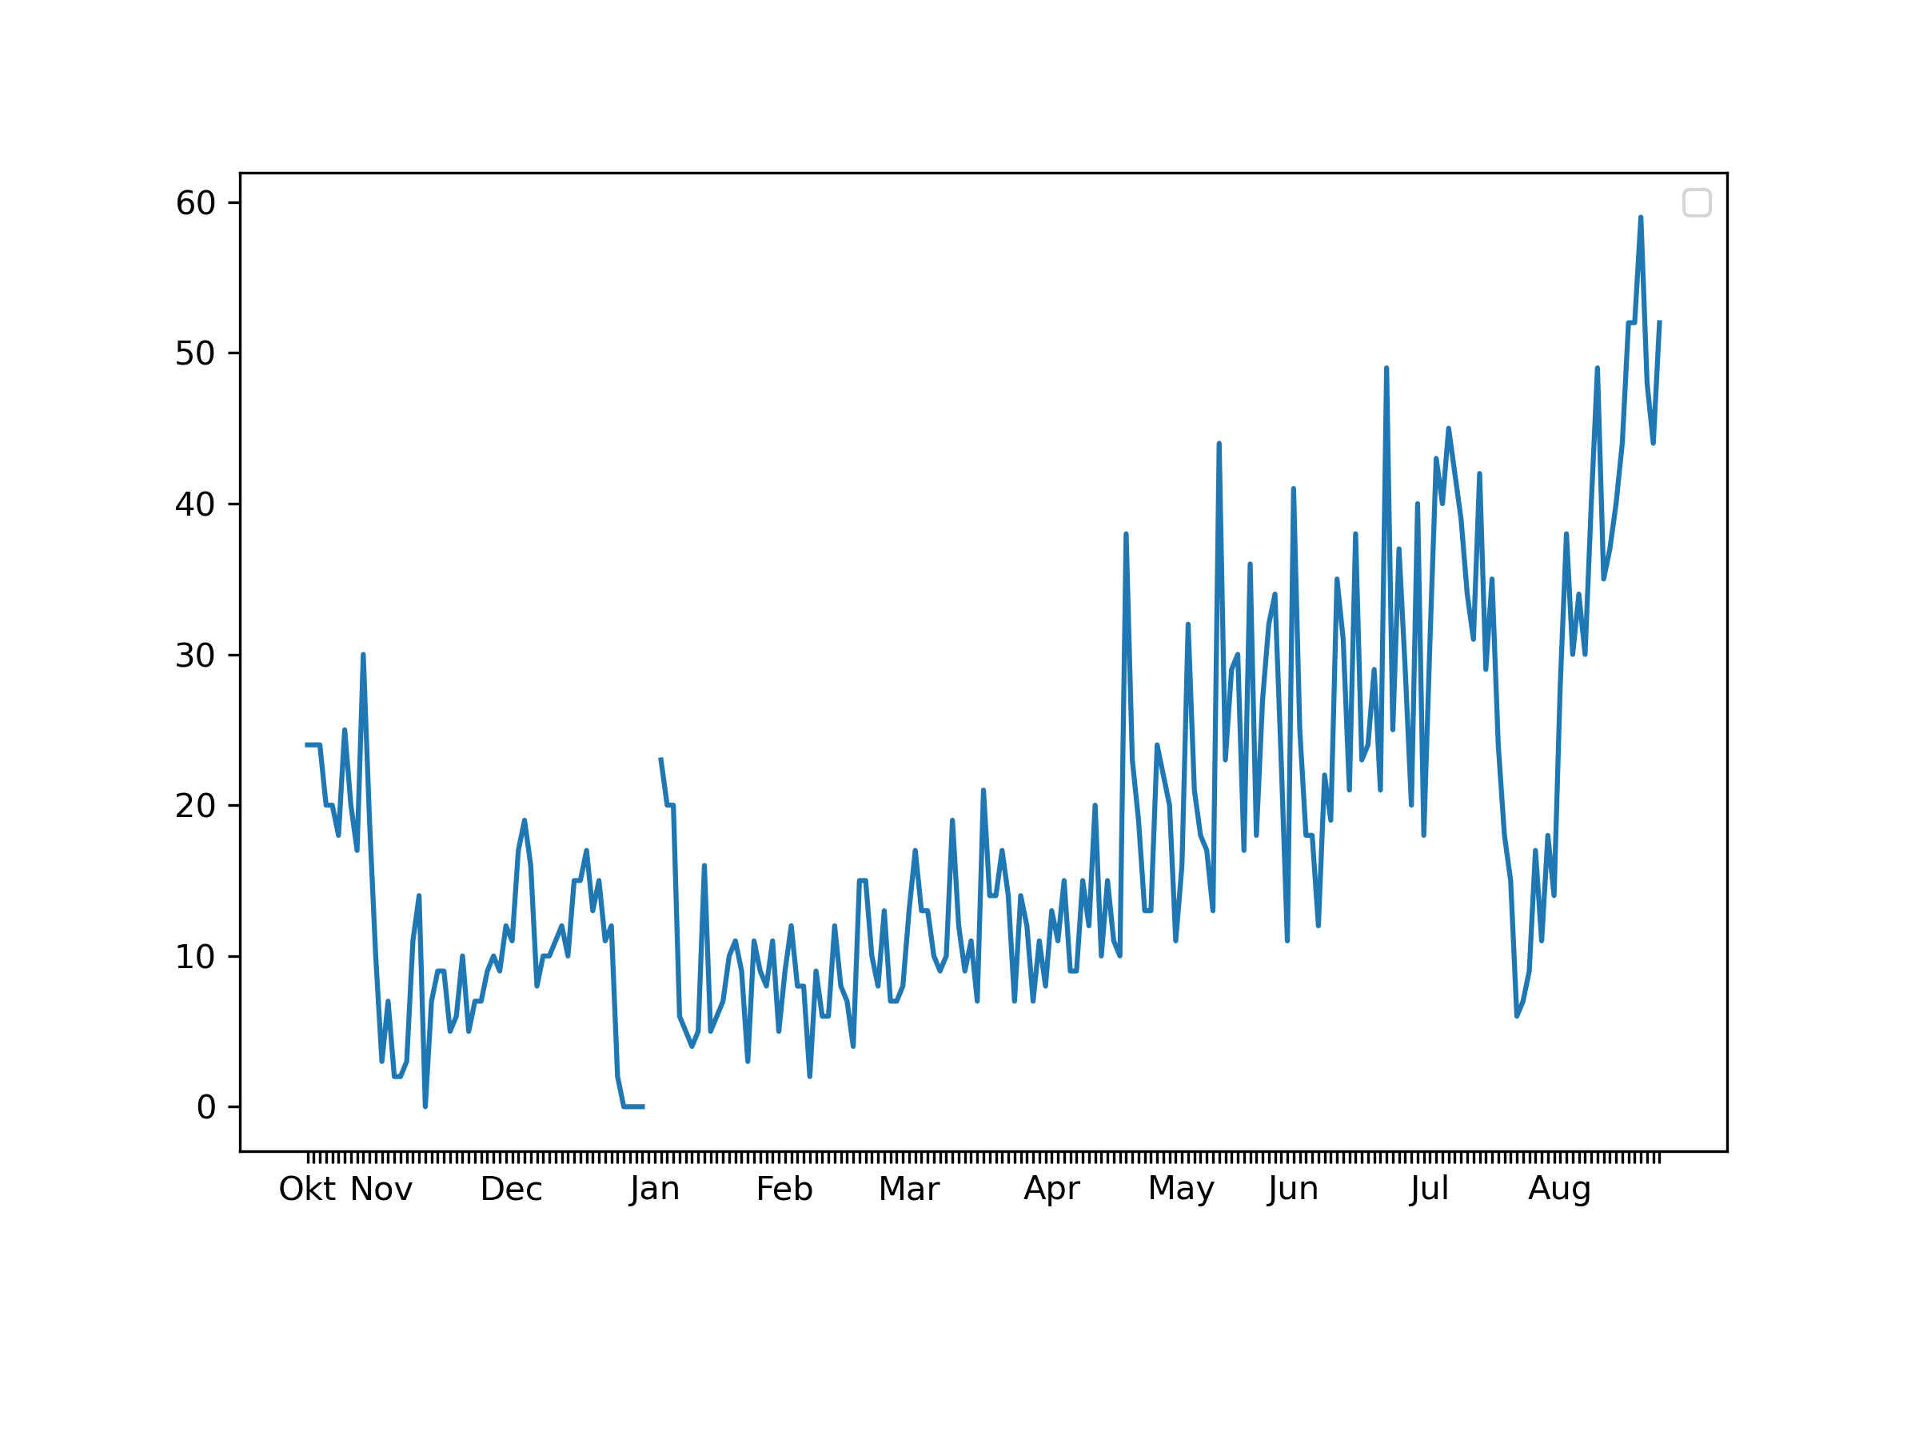
Occupancy rate

Slide 4
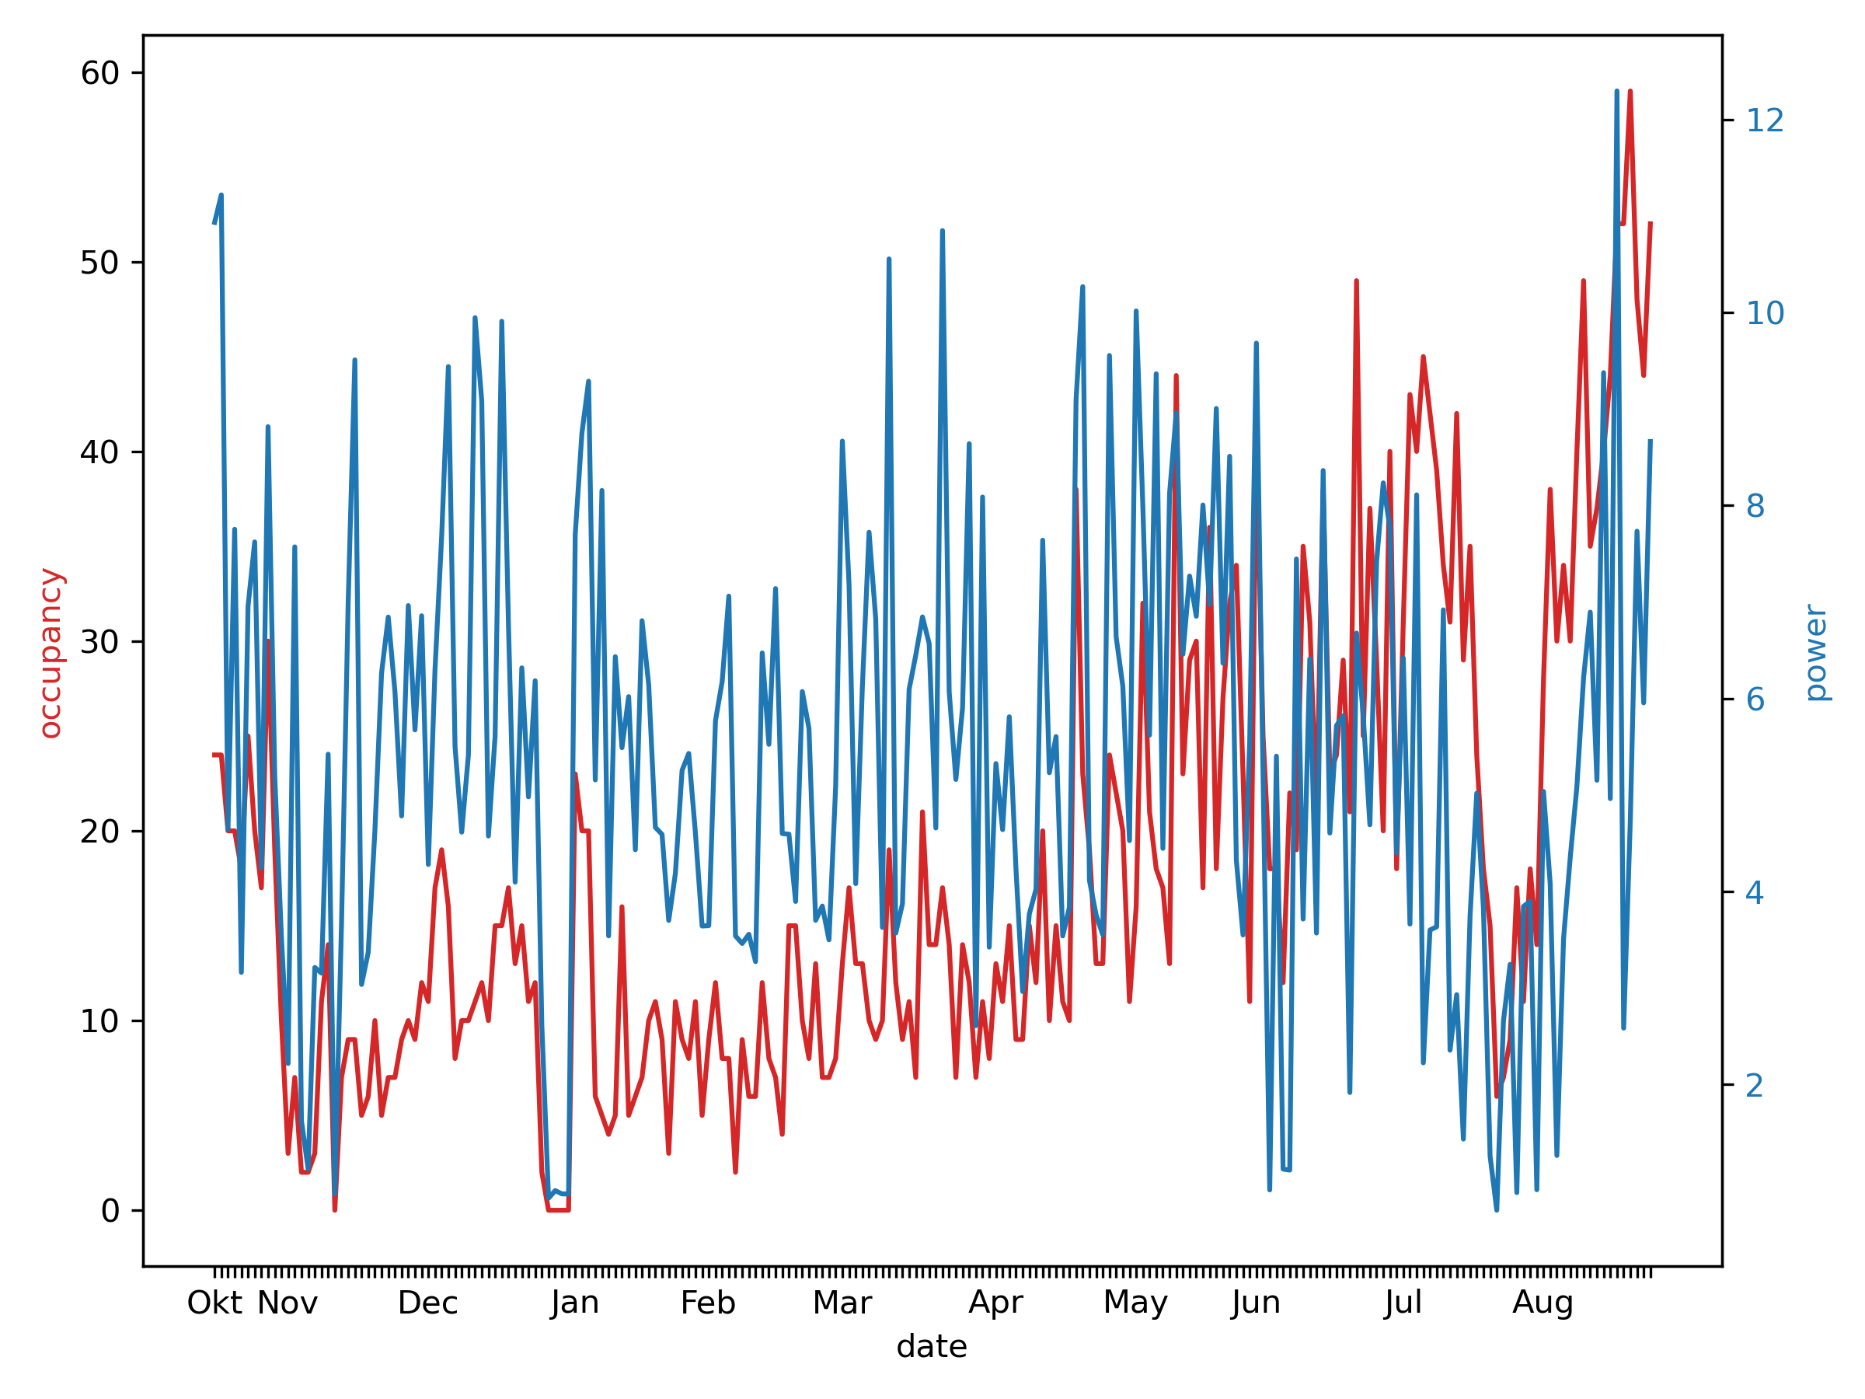
Occupancy rate – power consumption

Slide 5
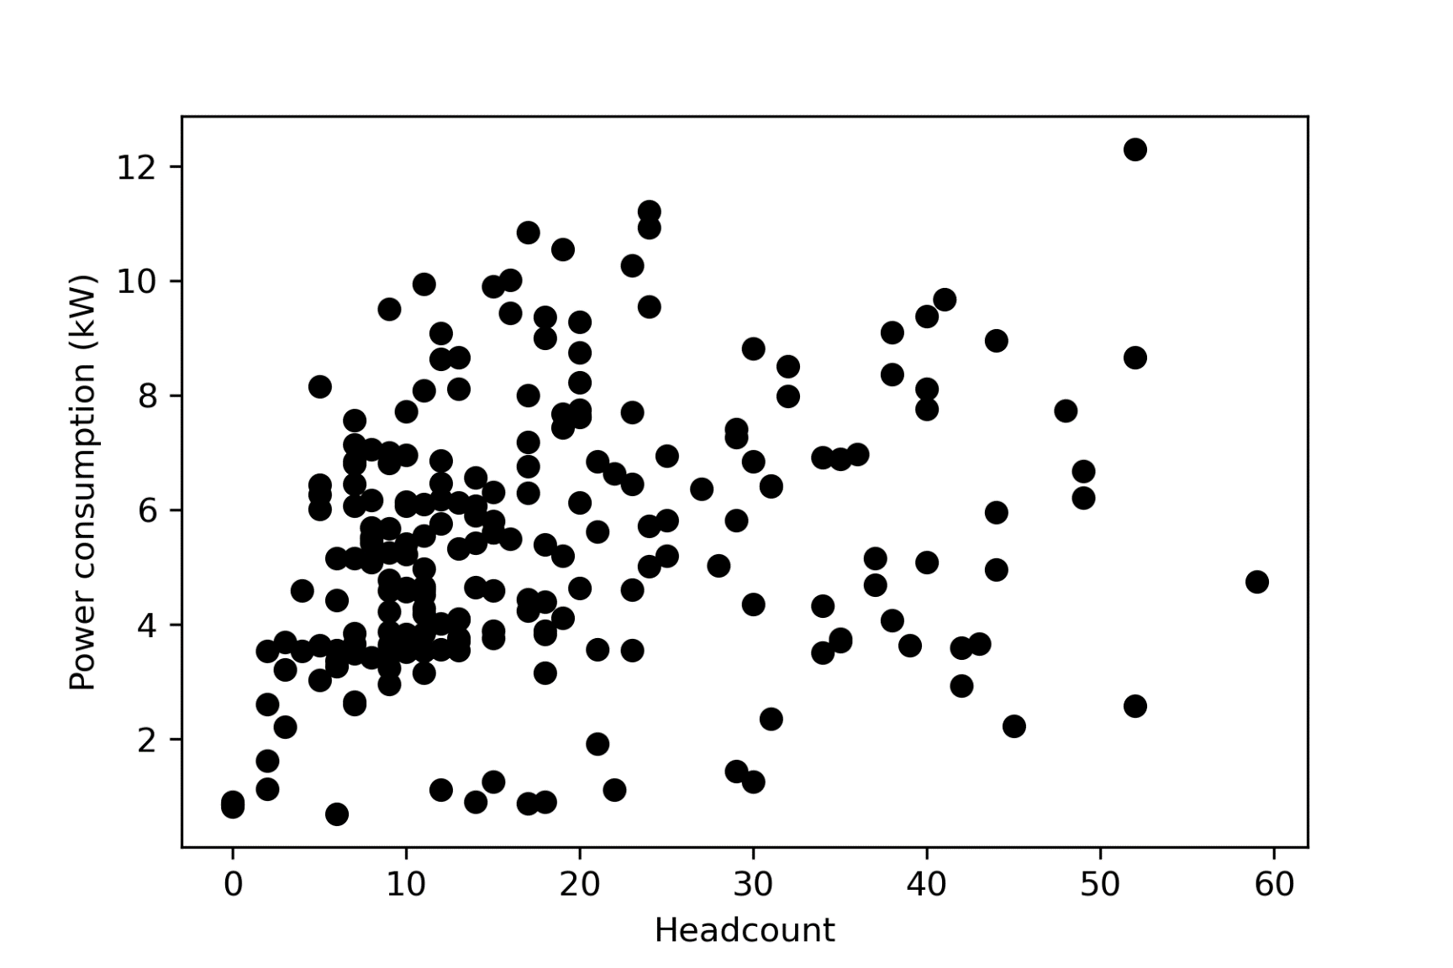
Scatterplot

Slide 6
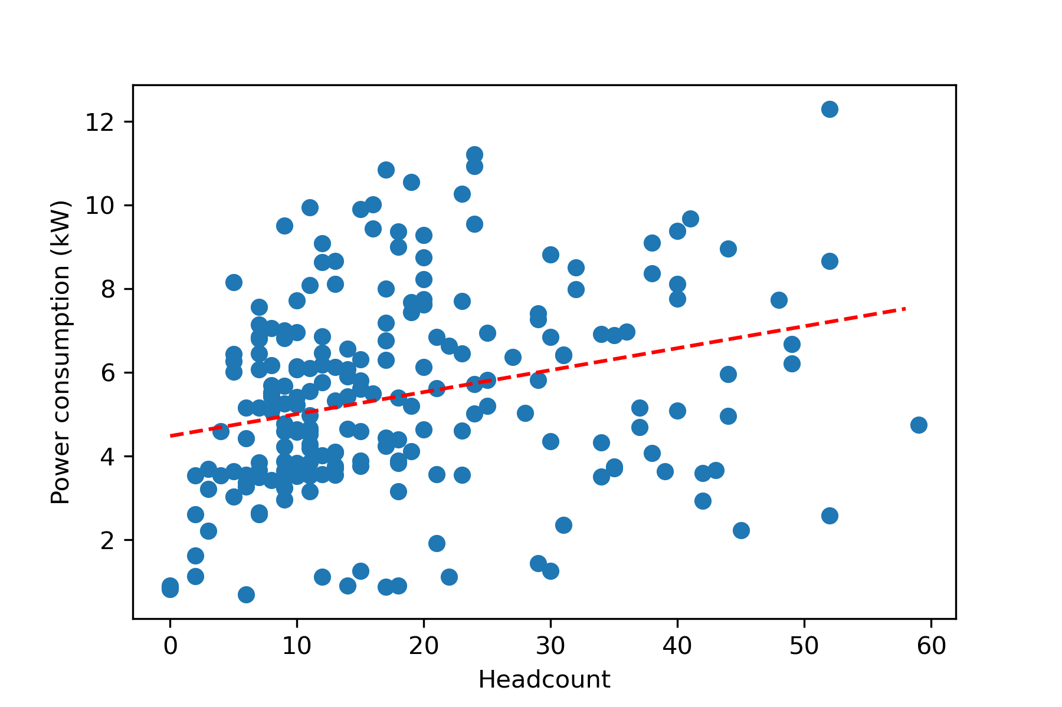
Scatterplot with linear regression
Base power consu;ption of ~4500 W + ~ 52W/person

Slide 7
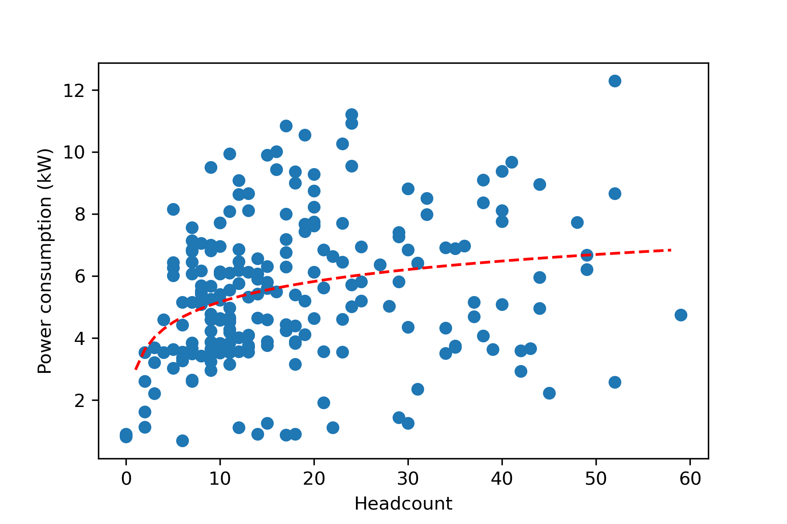
Scatterplot with logarithmic regression
Power= 3 kW + 0.95*log(HC)

Slide 8
Charging behavior

Slide 9
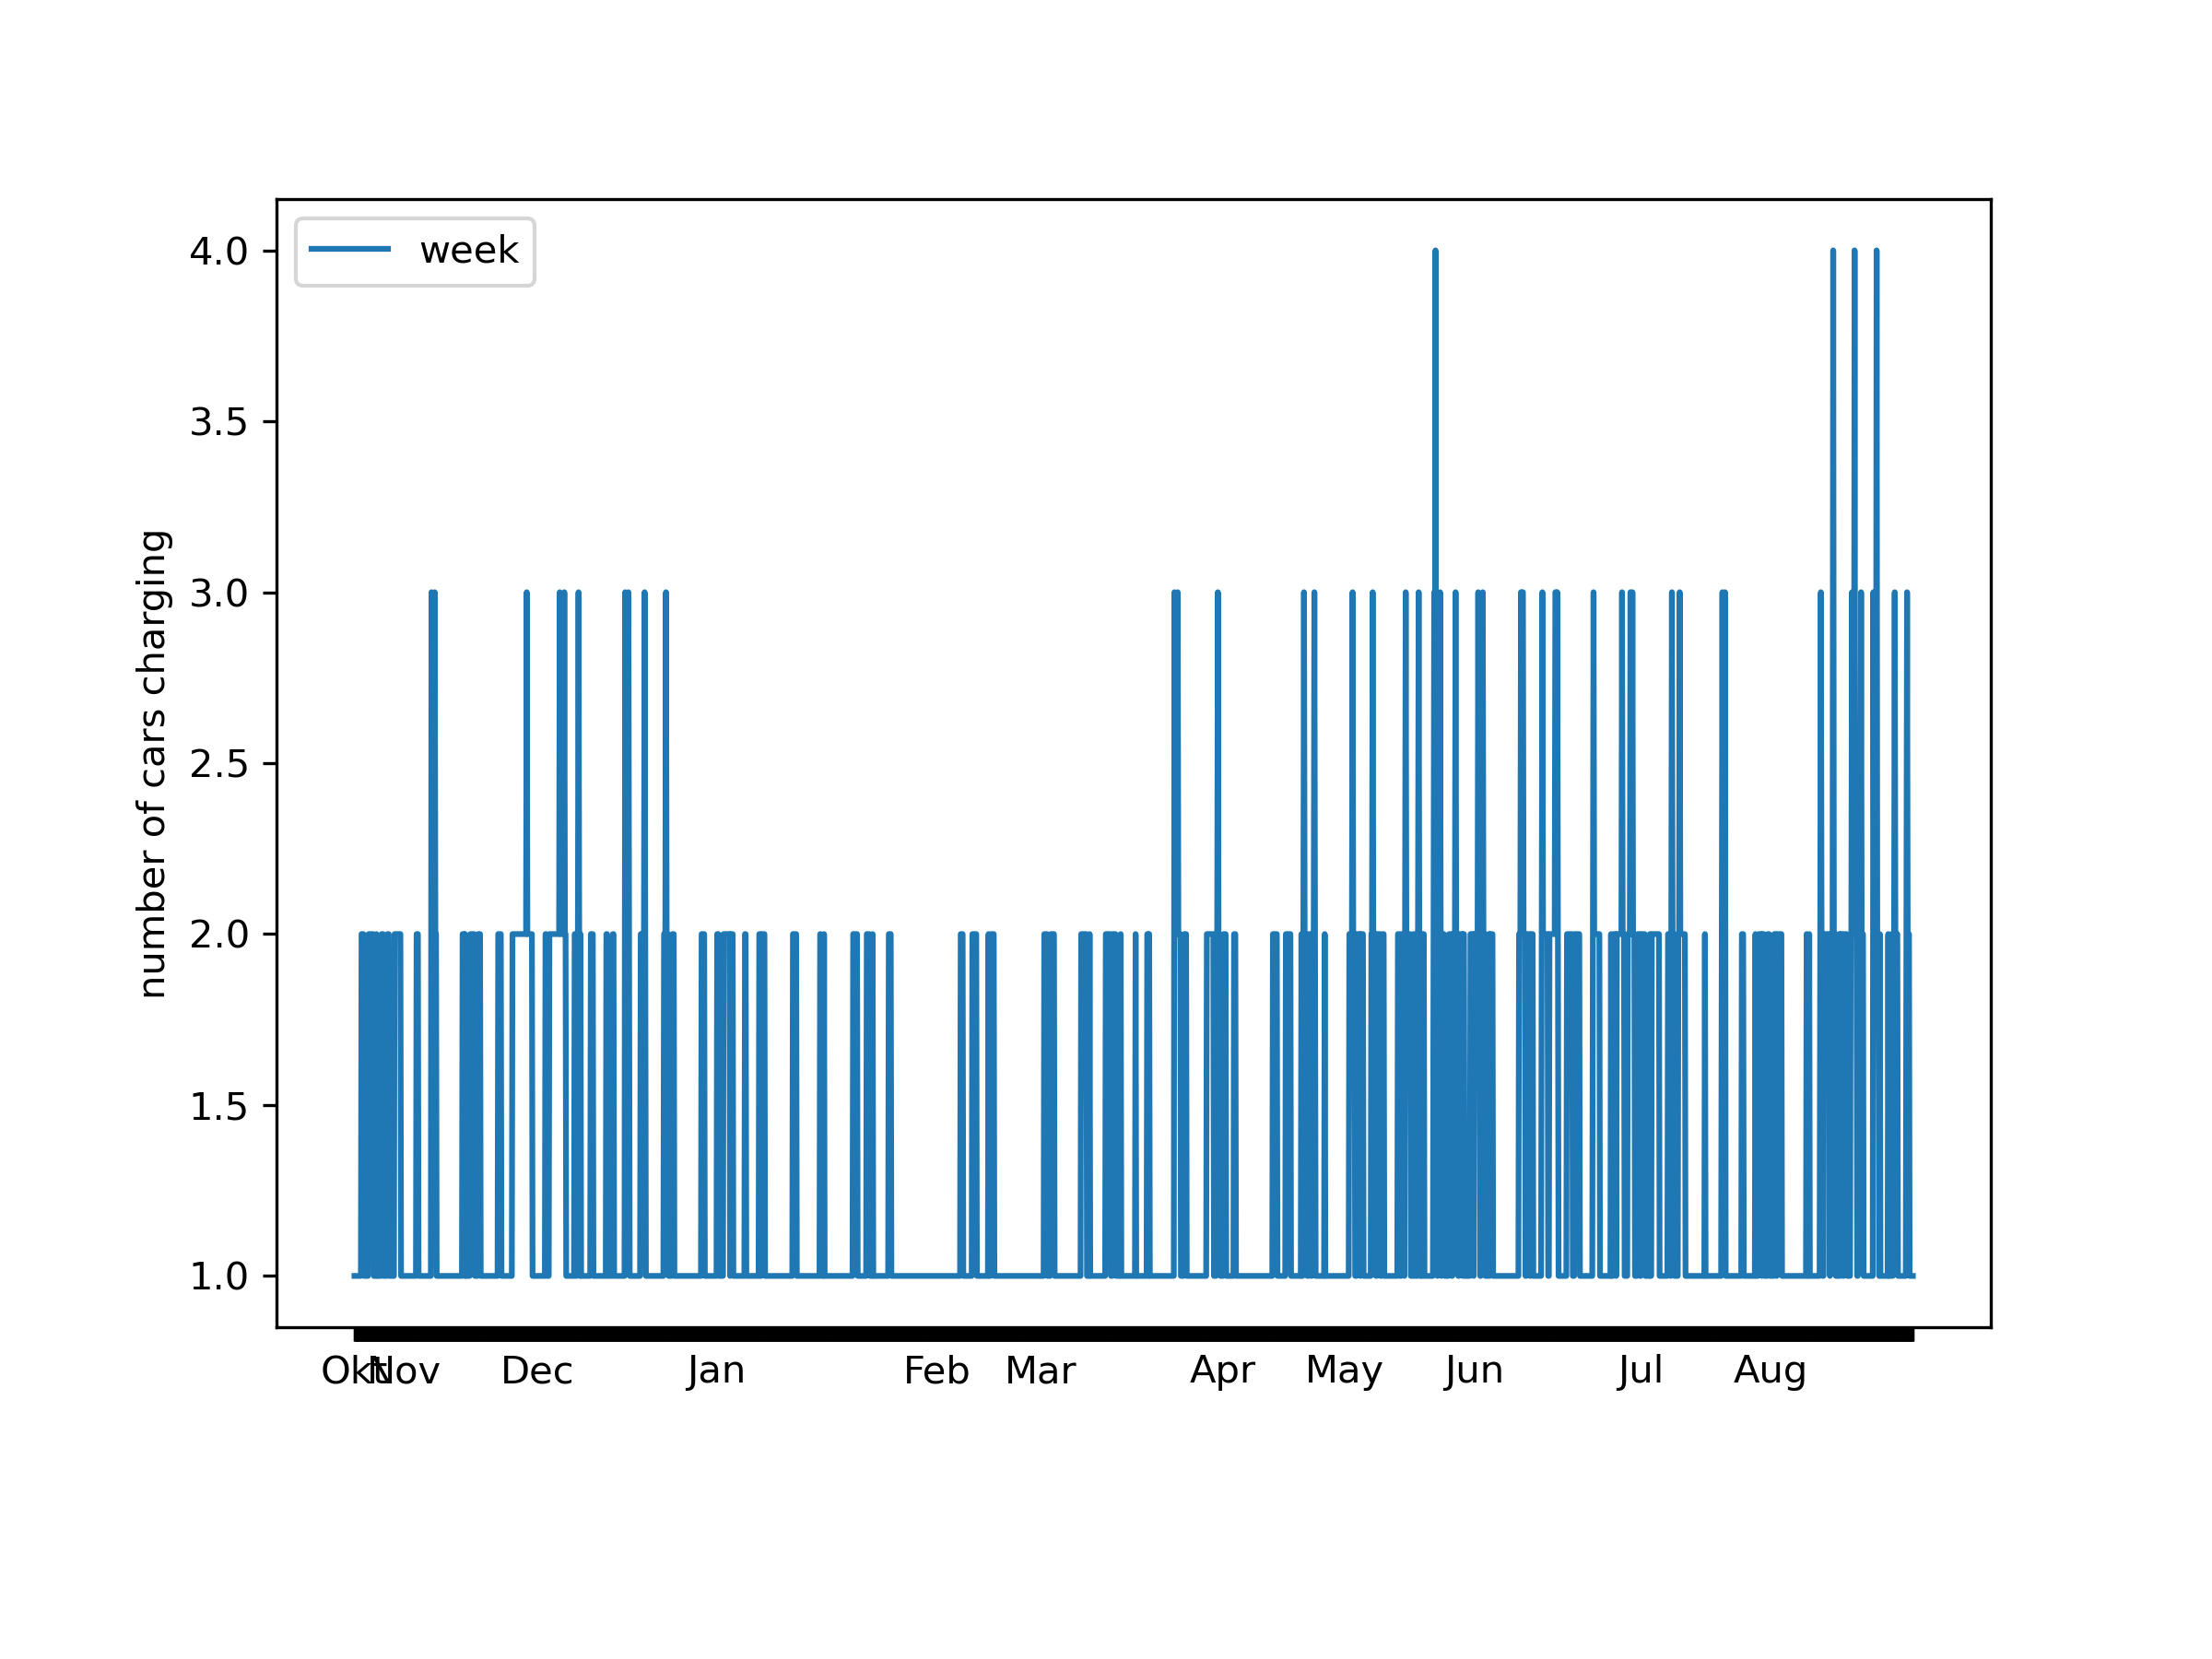
Number of cars charging

Slide 10
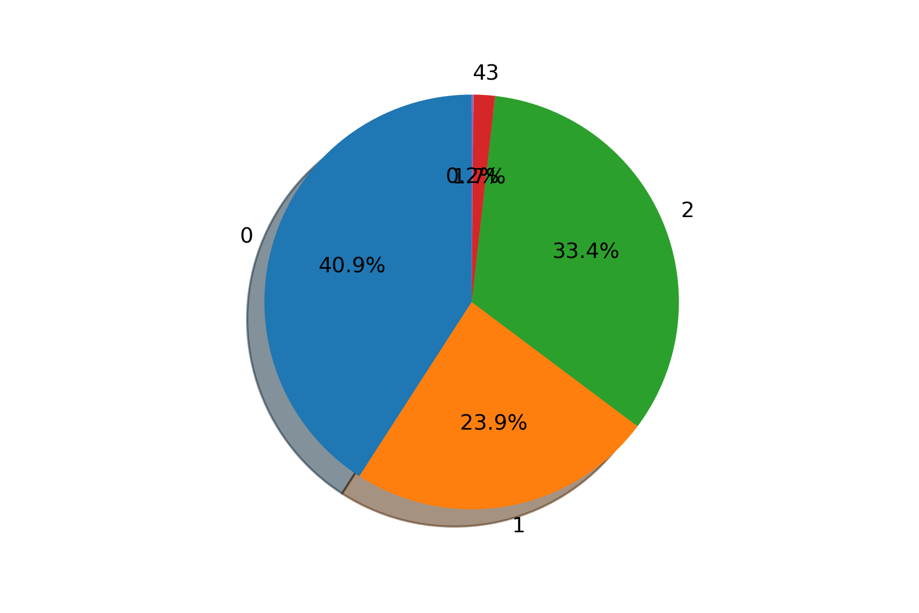
Number of cars charging

Slide 11
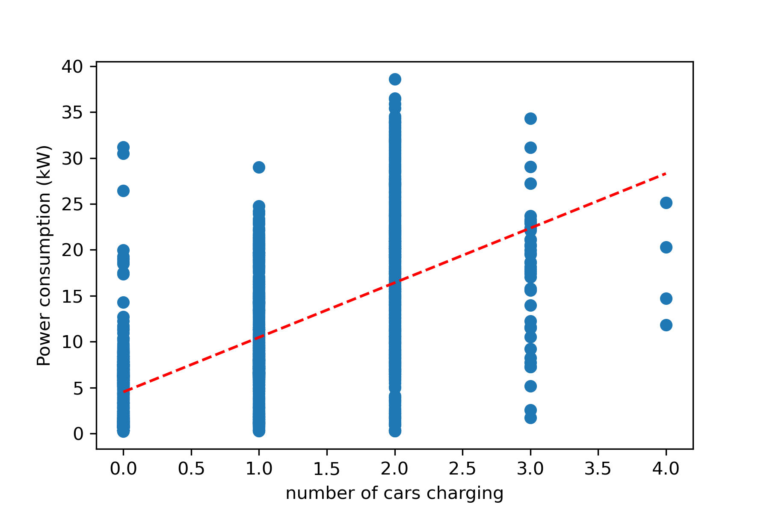
Scatterplot with linear regression

Slide 12
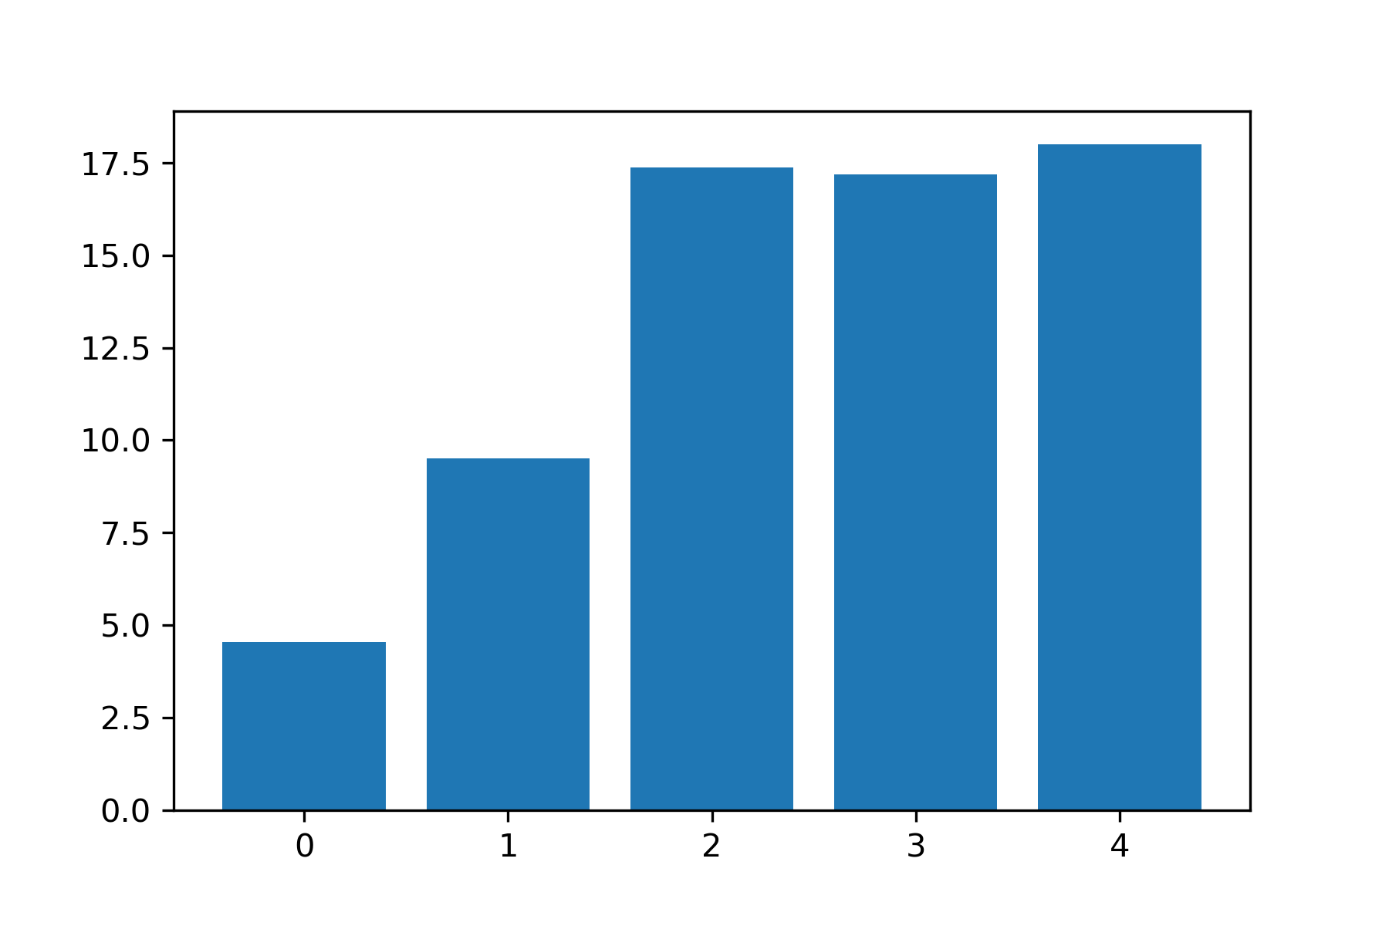
Number of cars charging versus energy consumption

Slide 13
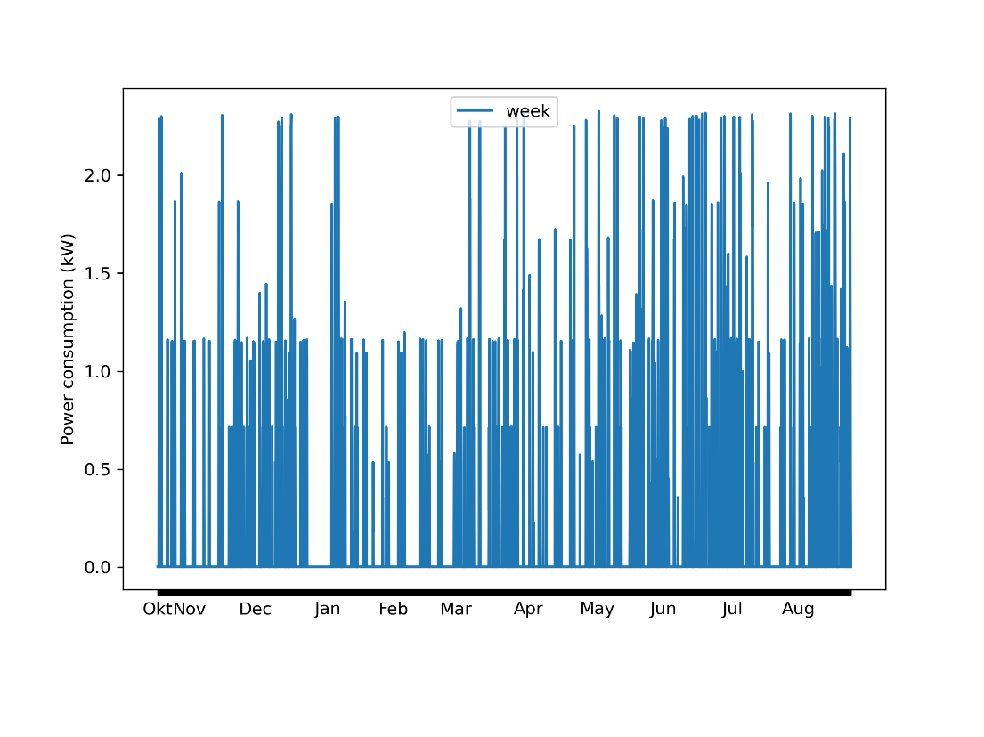
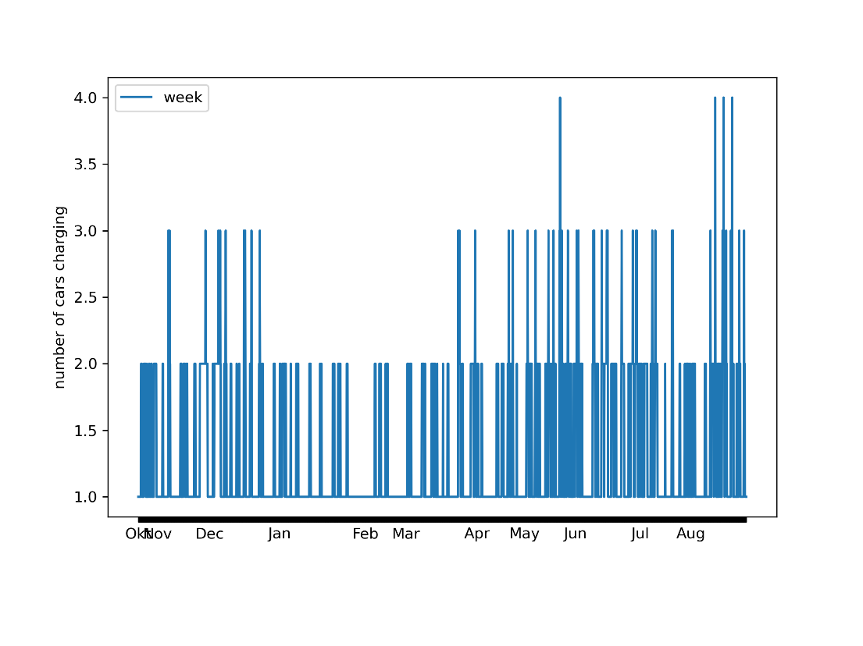
Power meter charging poles

Slide 14
Contribution to total energy consumption
4 % from charging
6 % when at least 1 car is charging

Slide 15
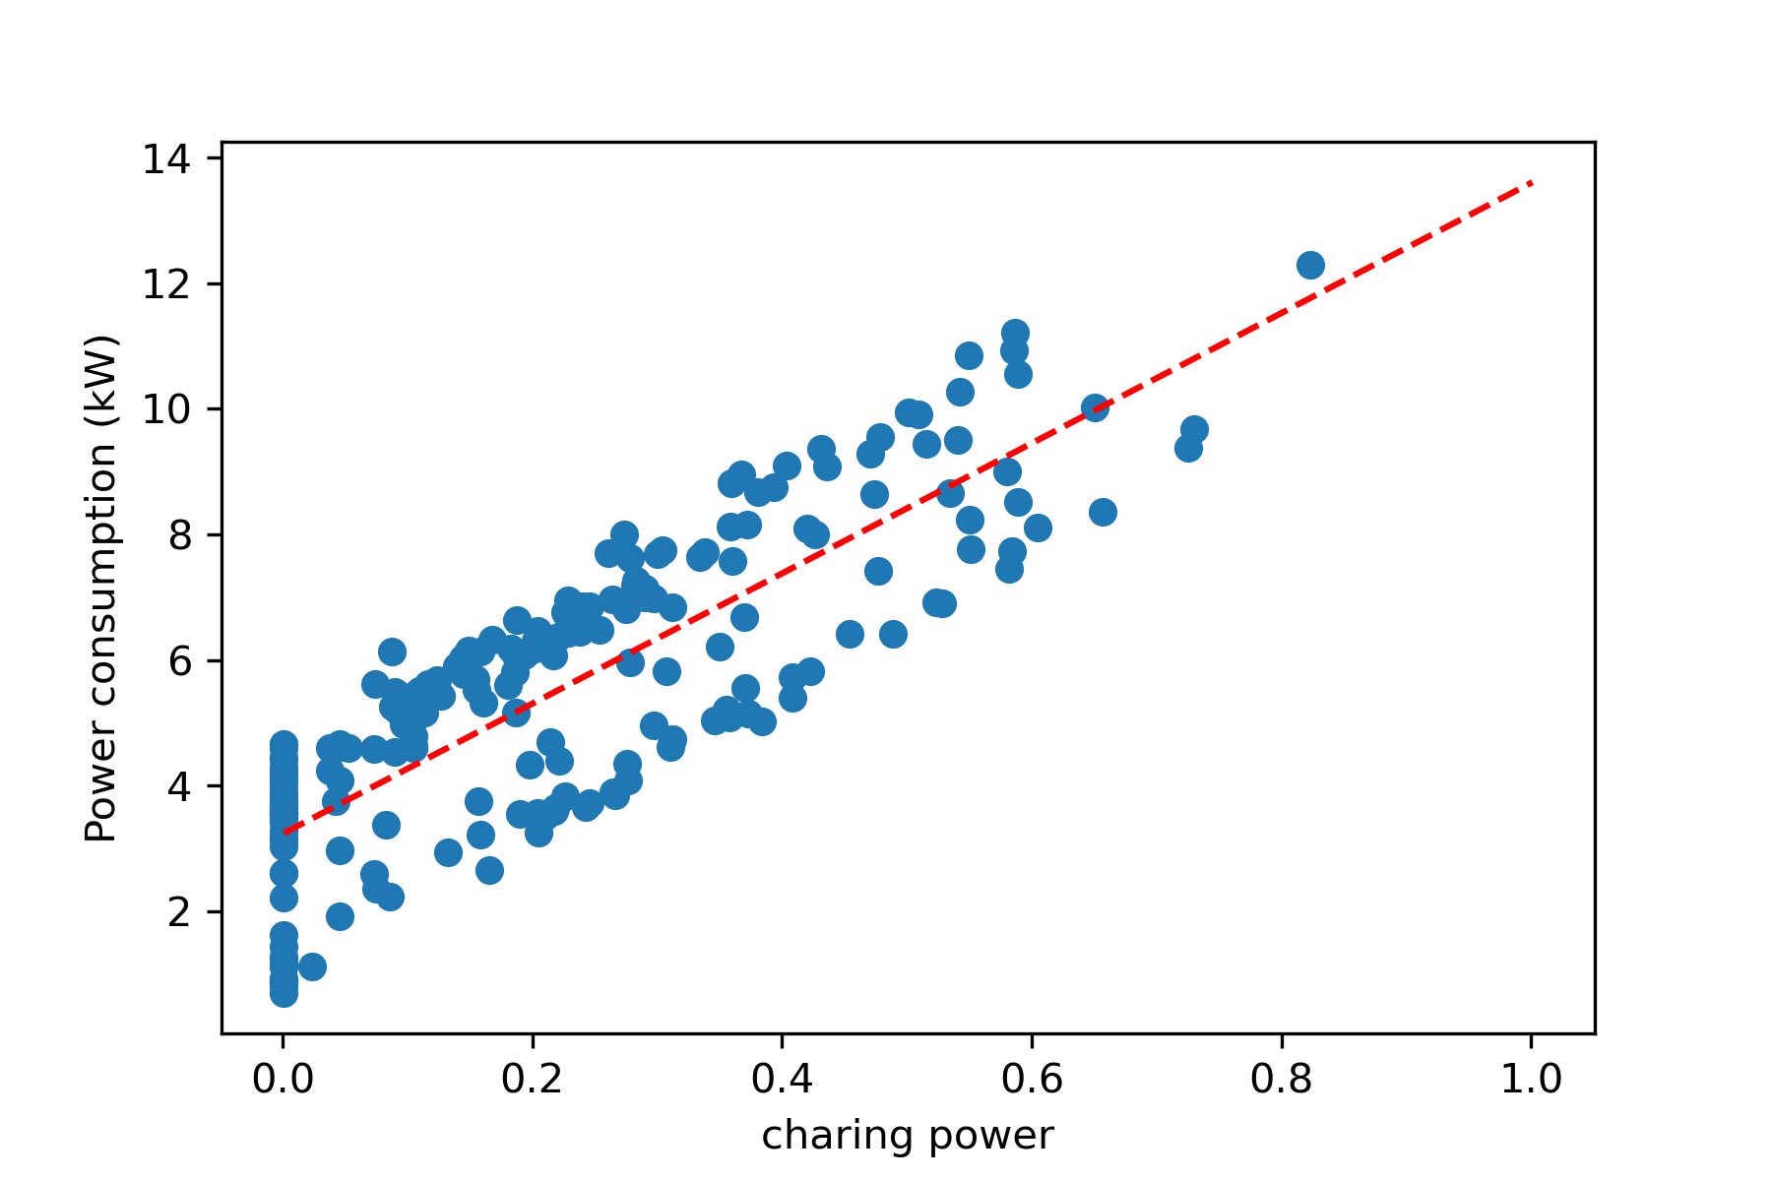
Scatterplot with linear regression

Slide 16
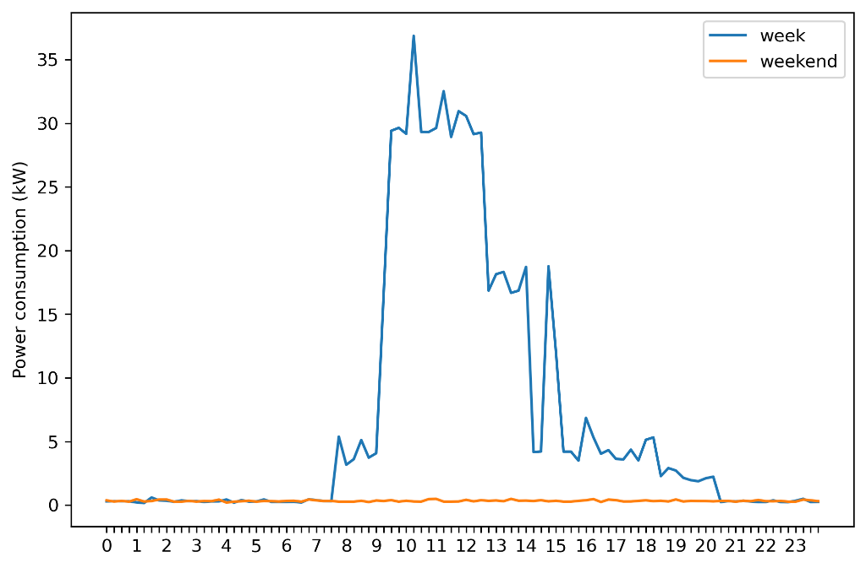
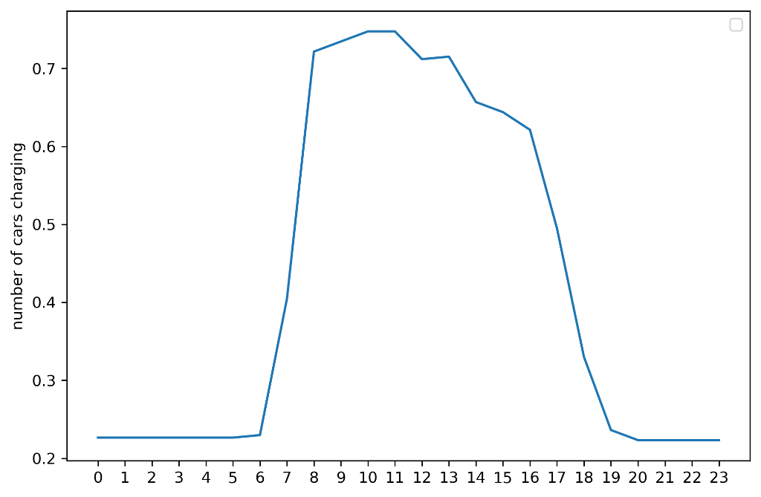
Average power consumption per hour

Slide 17
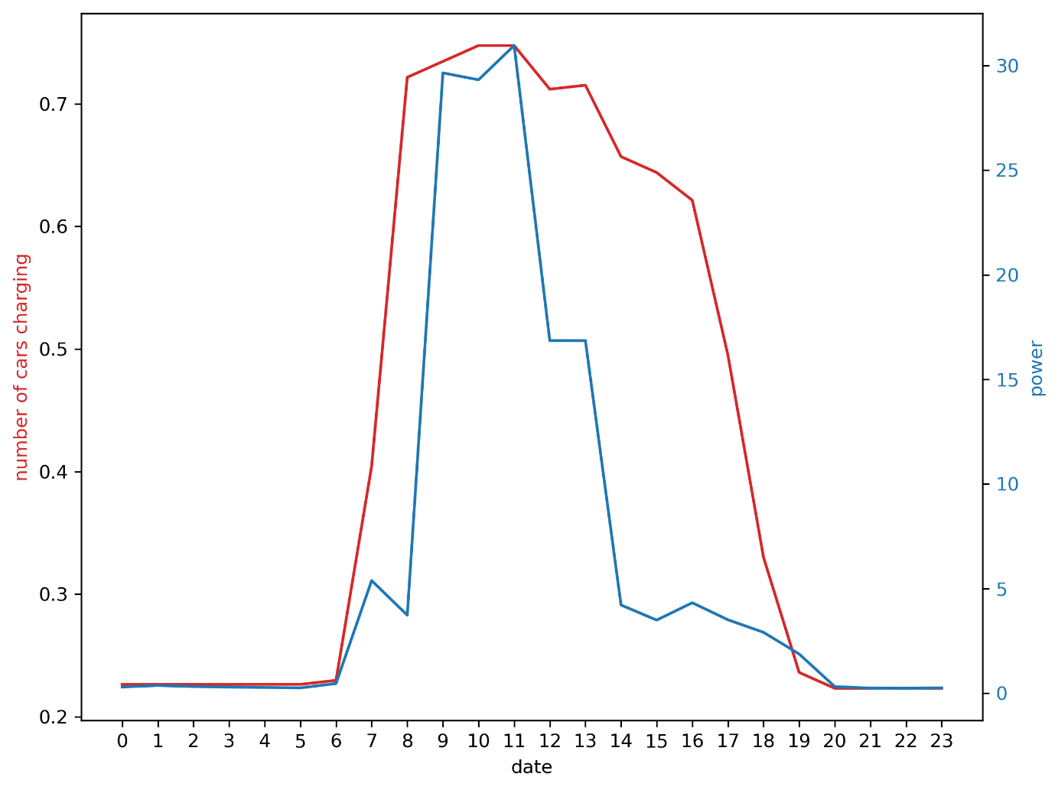
Number of cars charging– power consumption

